Slide 1
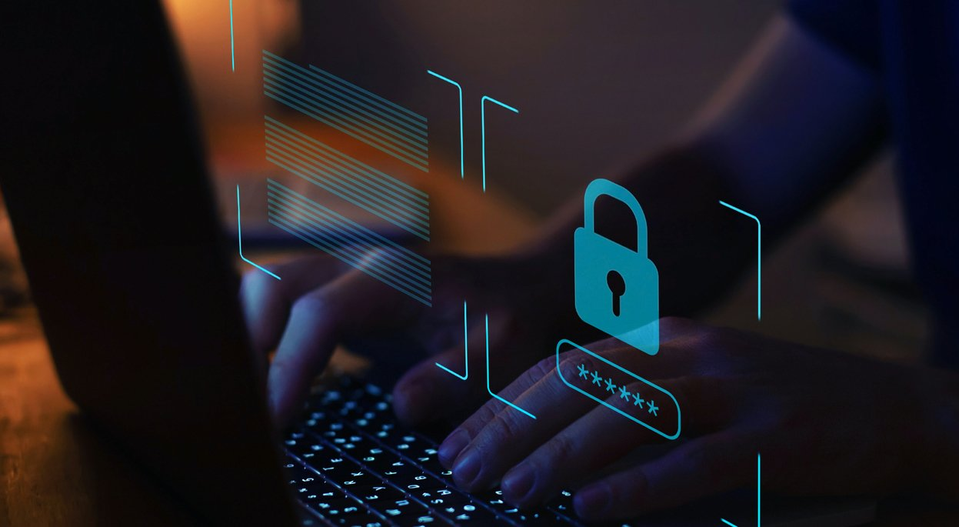
2024 SMALL BUSINESS CYBERSECURITY CHECKLIST
Emmanuel St Jour,
CTO, NOVASTRATICS

Slide 2
Why do SMBs need a cybersecurity plan?
In a world where cybercrime never sleeps, organizations need an “always on” cybersecurity plan. And for small-to-medium businesses (SMBs), the need is even greater because cybercriminals have significantly increased their focus on smaller organizations in recent years. Between 2021 and 2022, there was nearly a 200% increase in incidents targeting organizations with fewer than 1,000 employees.

Slide 3
Most Common Cyber Threats to SMBs
Ransomware
Social engineering^{[2]}
Credential stuffing
Ransomware is a type of malware that encrypts a victim’s data where the attacker demands for a “ransom”, or payment, in order to restore access to files and network.
Social engineering is an umbrella term that describes a variety of cyberattacks that use psychological tactics to manipulate people into taking a desired action, like giving up confidential information.
Credential stuffing is a cyberattack where cybercriminals use stolen login credentials from one system to attempt to access an unrelated system.
Security misconfigurations
and unpatched systems
A security misconfiguration arises when essential security settings are either not implemented or implemented with errors. Such errors create dangerous security gaps that leave the application and its data (and thus the organization itself) open to a cyber attack or breach.

Slide 4
Solution
Implement Security Defenses
Security technologies will give you a great defense to safeguard against the many attack vectors bad actors use. The right tools can become highly customized depending on your specific environment.
Understand Your Environment
Train Your Employees
The end game for cybercriminals is to gain access to your high-value data, so it’s important to take stock of your environment to understand the various devices and systems you have in place and where your valuable data resides.
Employees are a company’s best asset but, often, the weakest link in protecting against cyber threats. The human element continues to drive security incidents, contributing to 82% of breaches in 2022.
Maintain Good IT Security Hygiene
Cyber hygiene relates to the practices and precautions users take with the aim of keeping sensitive data organized, safe, and secure from theft and outside attacks.

Slide 5
Understand Your Environment
Expect a breach
Evaluate your device, facility and network landscape
Identify your IT security resources
When you know your environment well and prepare for a breach, it will give you a much better “leg up” to react quickly if a successful attack occurs. In this case, the old adage holds true: hope for the best, plan for the worst.
Encourage good safety practices for your corporate devices and laptops; these can be easily stolen if they’re left unattended
Keeping an organization’s infrastructure up and running securely requires a good deal of time and expertise. It’s important to assess your current resources to determine if you have any gaps in knowledge or manpower.

Slide 6
Implement Security Defenses
Install antivirus software across all devices
Implement Multiple security layers
Implement employee access limitations to data and software installations
Protecting your desktops, laptops and users’ mobile devices (all known as your endpoints) from malware, ransomware and other threats has always been an important security practice.
Every layer of additional protection matters. Based on your environment set up, most organization’s layers should include a firewall, patch management, endpoint protection, web and email content filtering, and multi-factor authentication
As a best practice, you should limit who has access to your organization’s high-value data. Putting an access control policy in place will help you establish guidelines that outline who can access data and resources for your business. You’ll also want to limit access to software installations;

Slide 7
Train Employees
Provide security awareness training
Create and enforce strong passwords
Create, enforce and continuously update a personnel security policy
Closing your employees’ knowledge gap by providing training on security best practices will mitigate this risk and empower your users to become an active part of your organization’s security defense.
Using and enforcing strong password practices with your users is also essential to prevent unauthorized access to your software-as-a-service (SaaS) applications, laptops and devices.
Putting a security policy in place will help align your ever-changing personnel on the expected rules and behavior to follow for meeting minimum IT security and data protection requirements.

Slide 8
Maintain Good IT Security Hygiene
Continuously back up data
Update software and patch systems
Perform Periodical review
Having regular and reliable data backups is an important IT practice for SMBs to adopt. It can prevent long-term damage from lost data due to a security incident, an accidental deletion or a natural disaster
Patch management is the cornerstone for your vulnerability management plan. Ensure you have a strong patch management process that’s always on and connected to provide the visibility you need into which patches are high priority
Periodical Review, either monthly, semi-annual or even annually might be crucial for your organization, as it helps to determine your security standpoint and plan for future.

Slide 9
Product benefits
Simple and efficient to use​
Quick customer service assistance​
Free 90-day trial for new customers​​

Slide 10
Thank you
Emmanuel St Jour​​
438-773-7844​
Emmanuel.stjour@novastratics.com
www.novastratics.com

